Slide 1

Subtitle

Slide 2
Developing steps
Proof of concept
Get all softwares ready
Business model
Forth stage

Slide 4
Developing steps
Proof of concept
Get all softwares ready
Business model
Forth stage

Slide 5
Pain point
Traffic jam , short distance , wasting boring time in transportation , sometime it's costed .

Slide 6
Bsklta
Bsklta will address the need for funny ,enjoyable , and a new way of the cheapest transportation . It will shift from four wheels to two wheels. ,It’s a bike sharing network where users grab a ride through mobile application

Slide 7
How Bsklta works?
To hitch a ride , a user opens the app ,uses his or her phone to get the password of bike and then unlock the bike's smart lock and begins the timer on the app . After finishing his or her ride and the locker become closed the timer will be off . The ride cost will deduct from credit . Customer can recharge by credit card

Slide 8
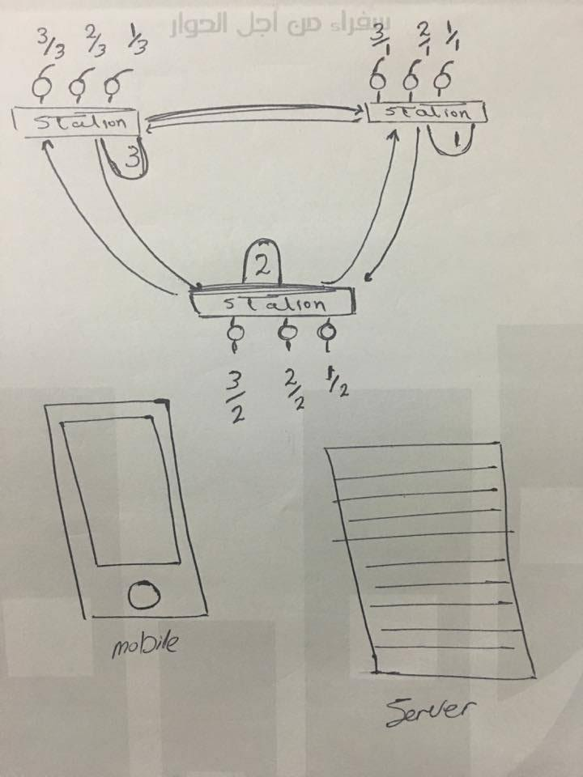
How Bsklta works?
Handwritten

Slide 9
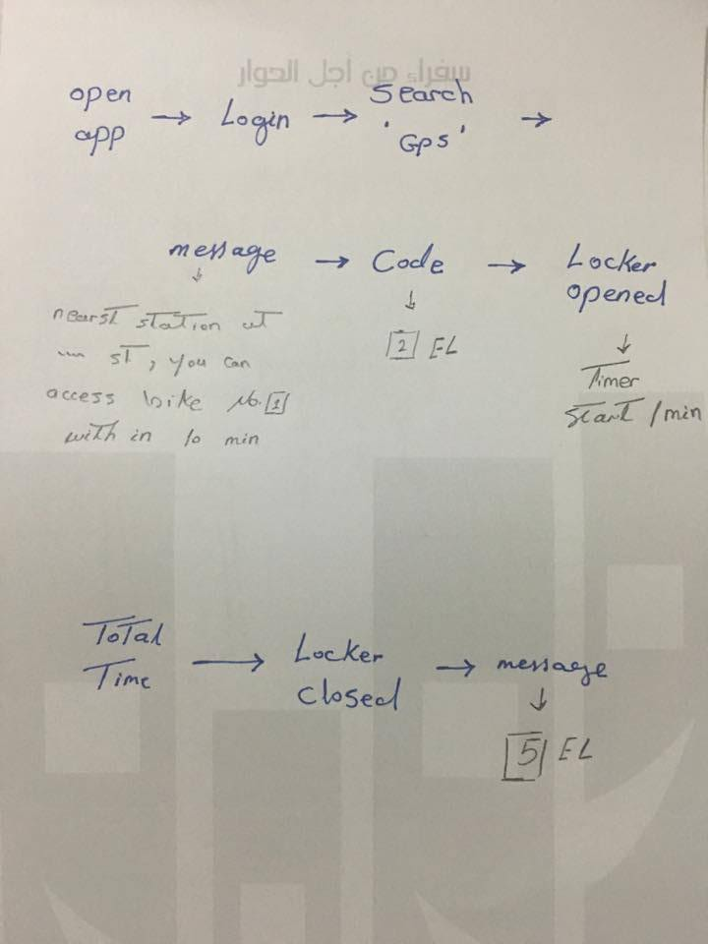
How Bsklta works?
Handwritten

Slide 10
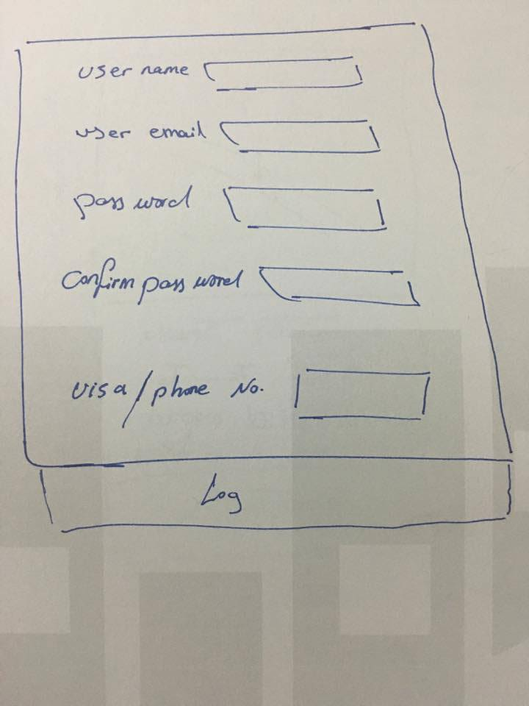
How Bsklta works?
Handwritten

Slide 11
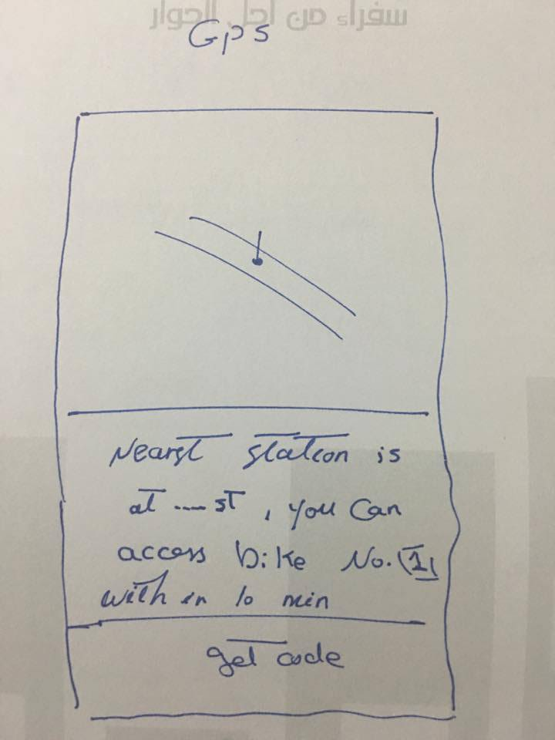
How Bsklta works?
Handwritten

Slide 12
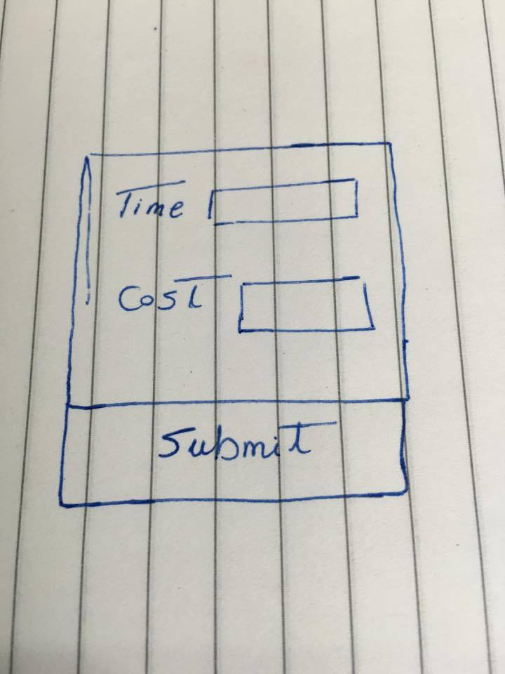
How Bsklta works?
Handwritten

Slide 13
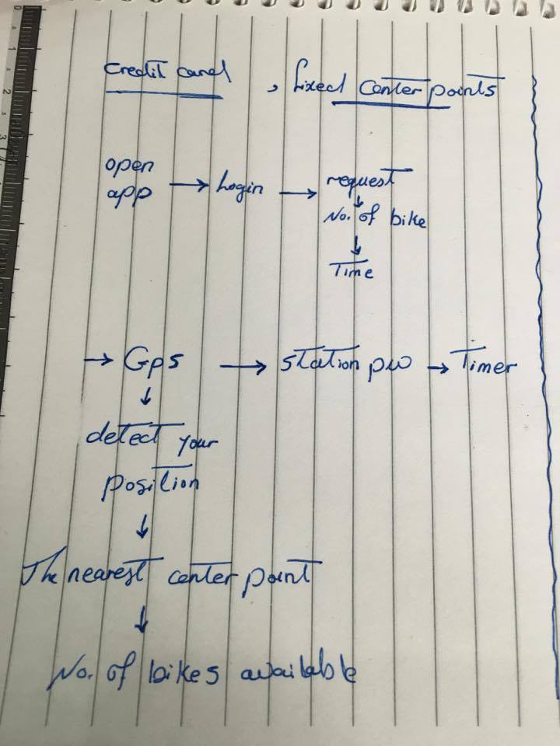
How Bsklta works?
Developing
Handwritten

Slide 14
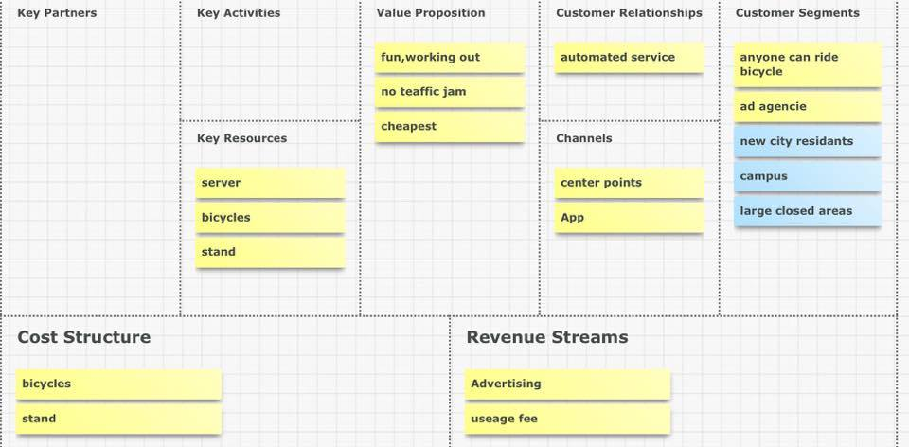
Business Module
Canvani-zer.com

Slide 15
Developing steps
Proof of concept
Get all softwares ready
Business model
Forth stage

Slide 16
Proof of concept

Slide 17
Hardware and wiring
Arduino Uno/Mega x1
Breadboard x1
4×4 Keypad x1
Servo Motor x1
Red LED x1
Green LED x1
220 Ohm x2
Jumper Cable

Slide 18
software
Arduino file
Reference:sief

Slide 19
Developing steps
Proof of concept
Get all softwares ready
Business model
Forth stage

Slide 20
Get All Software Ready
Server
Hardware
Software
Front end
Back end
Eagle
Python(programing language)
Arduino
,,,,.stl
HTML
CSS
LAMP
Java Script
Django(platform)

Slide 21
Get All Software Ready
Server
Hardware
Software
Front end
Back end
Eagle
Python(programing language)
Arduino
,,,,.stl
HTML
CSS
LAMP
Java Script
Django(platform)

Slide 22
Front end
Front-end is what you see (design, typography, colors, etc).
By typing the code at any text editor (sublime) and saving the file with .html extension for HTML , .css extension for CSS stylesheet and .js for JavaScript files .

Slide 23
Get All Software Ready
Server
Hardware
Software
Front end
Back end
Eagle
Python(programing language)
Arduino
,,,,.stl
HTML
CSS
LAMP
Java Script
Django(platform)

Slide 24
Back End
Python, Django (ubuntu 14.04)
In the terminal :1) pip
2) sudo apt-get install python-pip
3)sudo pip install django
You can test that the installation was successful by typing:
Django-admin –version

Slide 25
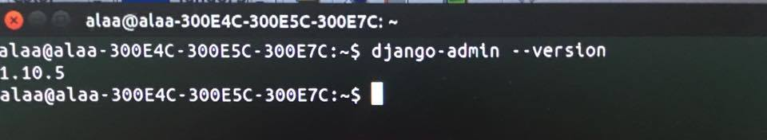
Back End

Slide 26
Back End
LAMP stack is a group of open source software used to get web servers up and running. The acronym stands for Linux, Apache, MySQL, and PHP.
Installation

Slide 27
Get All Software Ready
Server
Hardware
Software
Front end
Back end
Eagle
Python(programing language)
Arduino
,,,,.stl
HTML
CSS
LAMP
Java Script
Django(platform)

Slide 28
software
Arduino
Open-source electronic prototyping platform enabling users to create interactive electronic objects.
You can install it directly from software center

Slide 29
Get All Software Ready
Server
Hardware
Software
Front end
Back end
Eagle
Python(programing language)
Arduino
,,,,.stl
HTML
CSS
LAMP
Java Script
Django(platform)

Slide 30
Hardware
Eagle :CAD software used for PCB designing and schematic
Installing: download suitable version-extract this file – create your on autodesk

Slide 31
Hardware
.sql

Slide 32
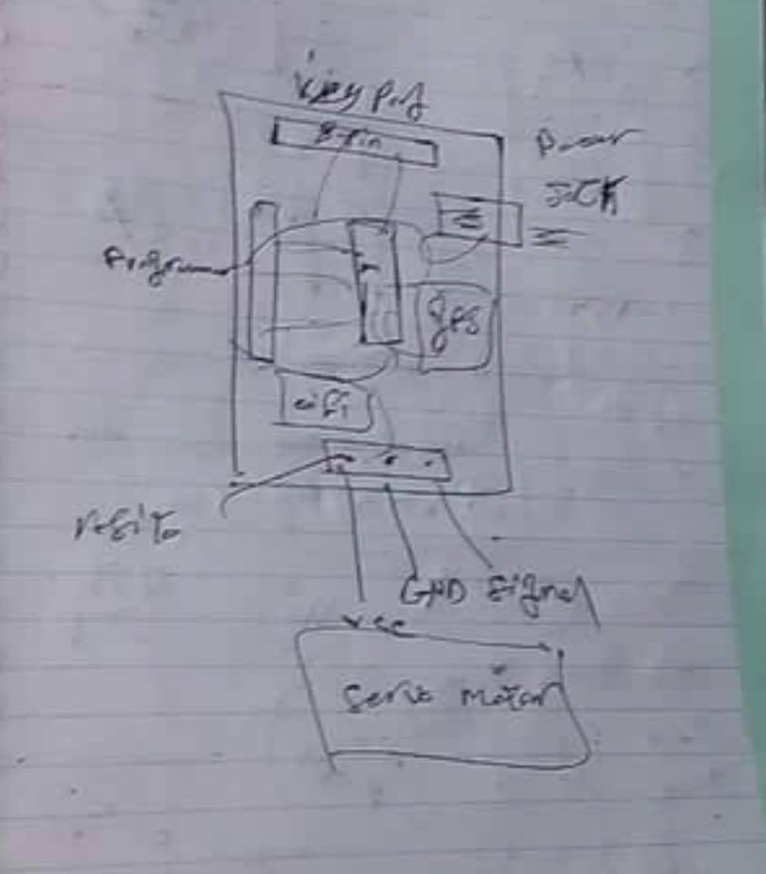
Eagle
Reference:Islam

Slide 33
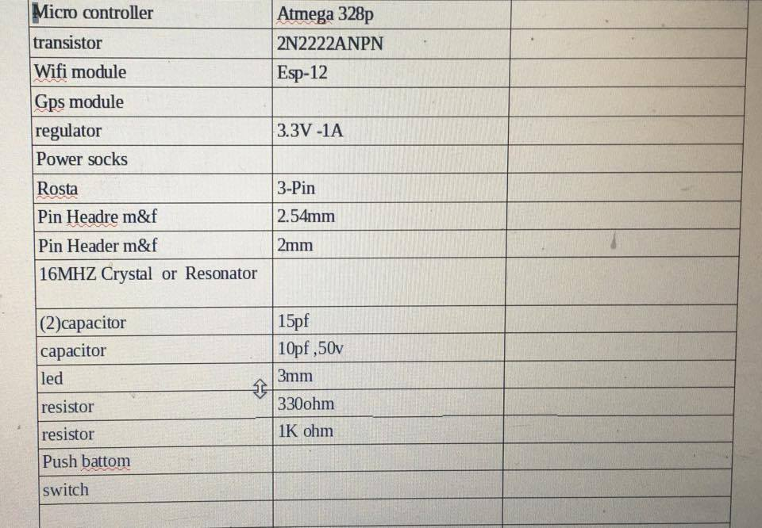
Eagle

Slide 34
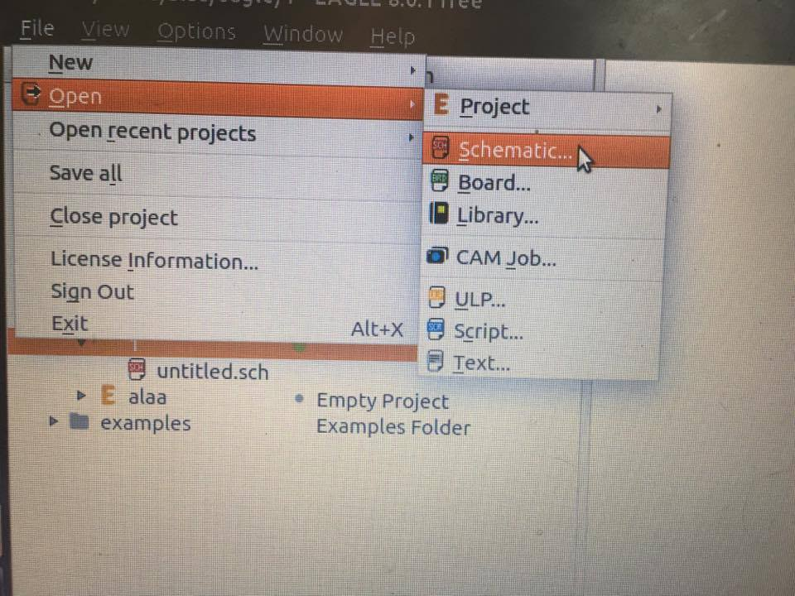
Eagle

Slide 35
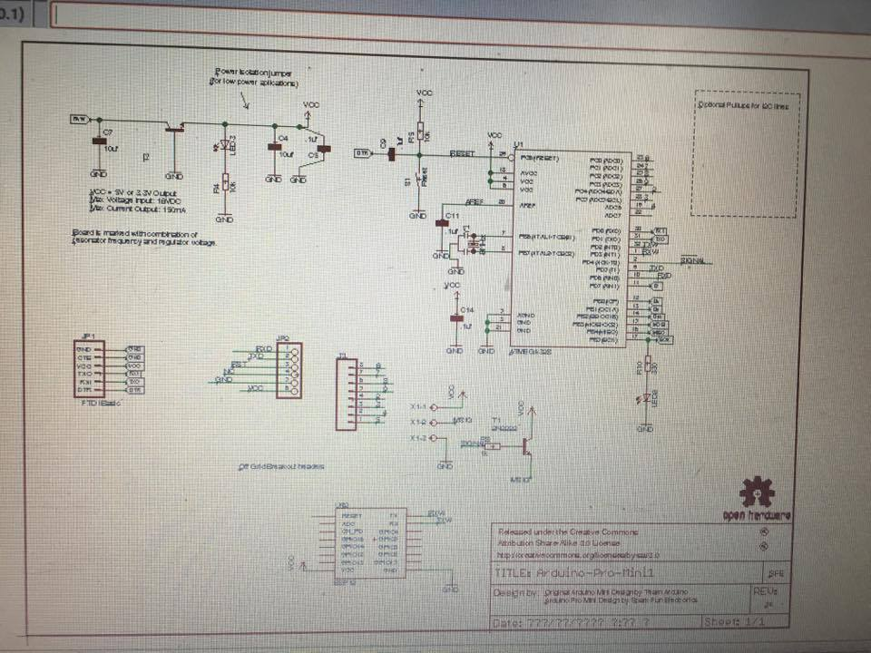
Eagle

Slide 36
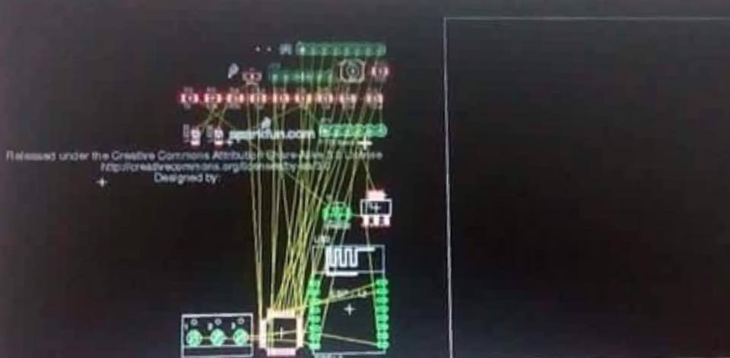
Eagle

Slide 37
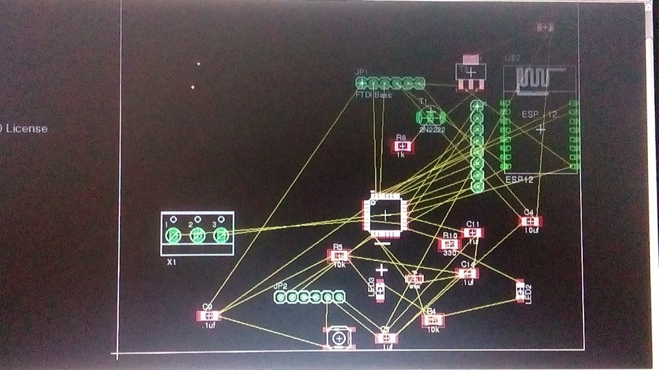
Eagle

Slide 38
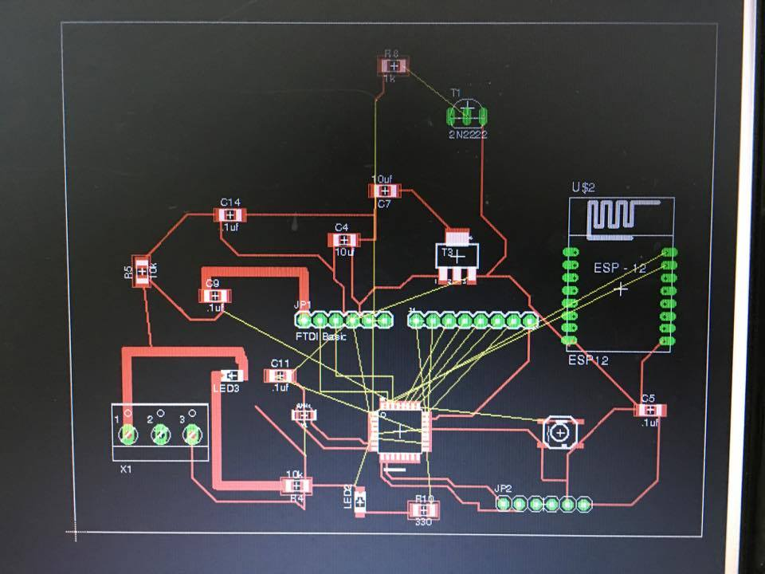
Eagle

Slide 39
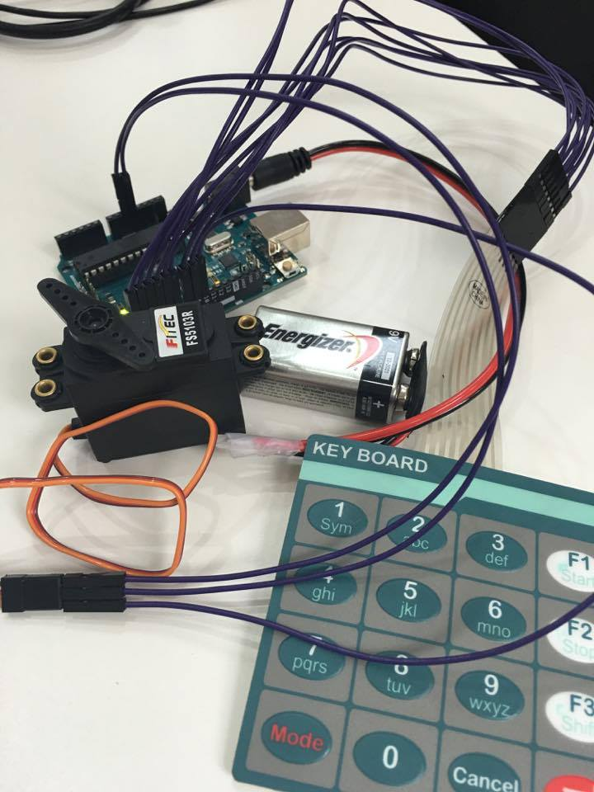
Arduino

Slide 40
Arduino
Reference:mahmod

Slide 41
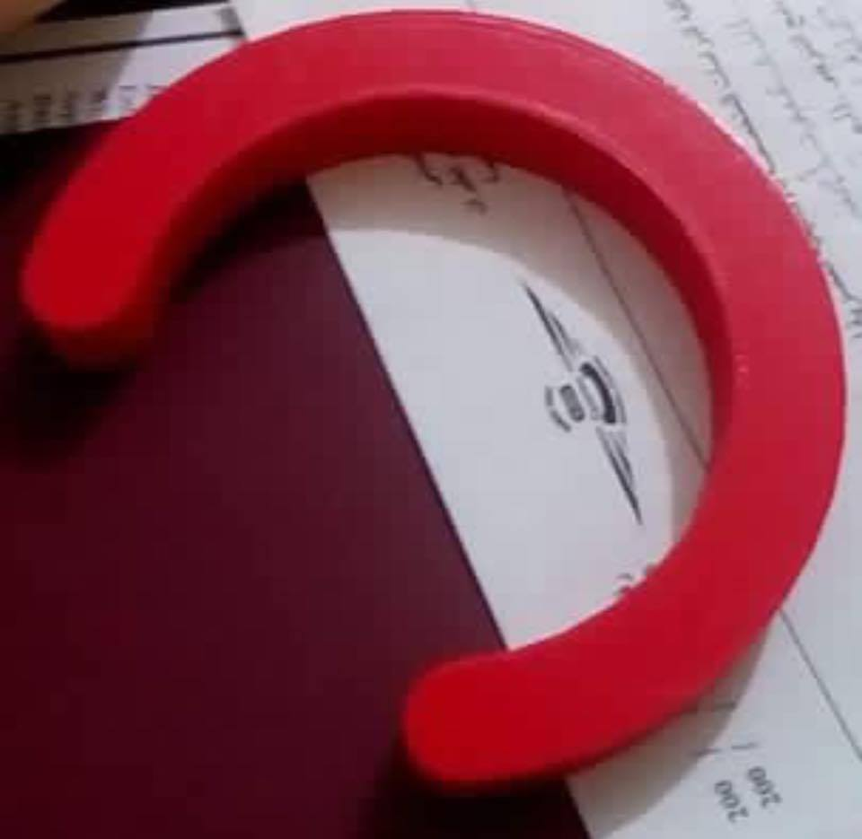
Haedware
Reference:Ranya

Slide 42
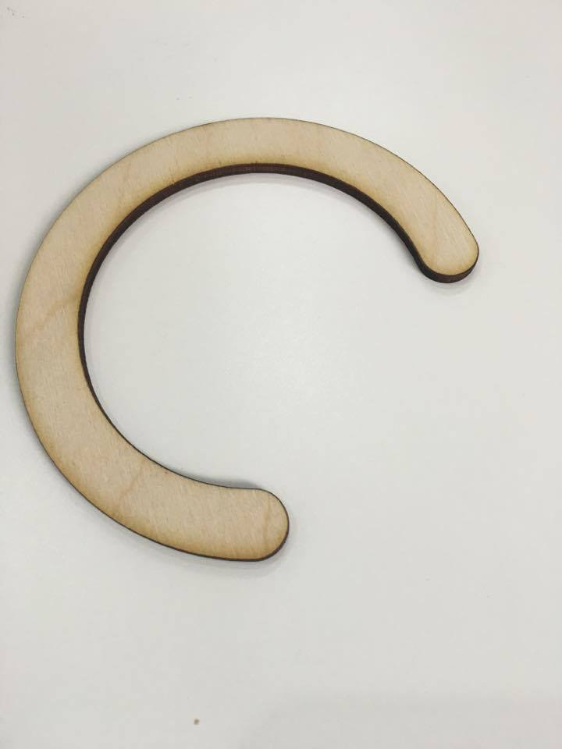
Haedware
Reference:Ranya

Slide 43
Front End
HTML
HTML5
TASK1

Slide 44
What next?
Product
Front End
Business model
Arduino Circuit
Back End
Business Plan
Scalable Prototype

Slide 45
Haedware

Slide 46
Haedware

Slide 47
Haedware

Slide 48
Haedware

Slide 49
Haedware

Slide 50
Haedware

